Slide 1
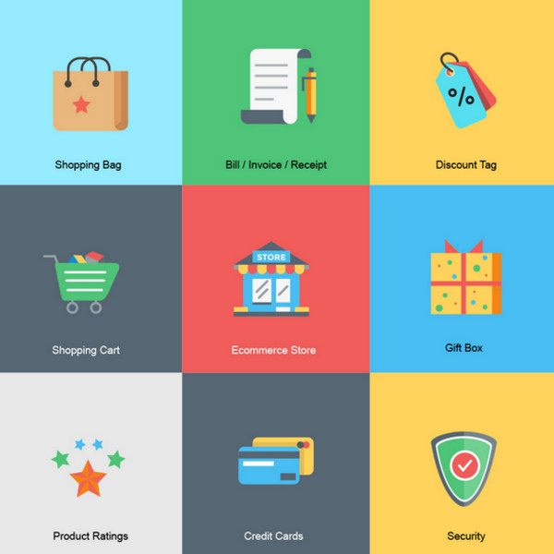
SAMOO STORE
ONLINE SHOPPING CART

Slide 2
INTRODUCTION
Shopping is one of the essential part of our daily life. We’re using different types of shops to buy different kind of things everyday.
Today our life is divided into two parts:
Physical Life: We meet everyone personally.
Virtual Life: We meet people on virtual a world called “INTERNET”.

Slide 3
ONLINE SHOPPING
Online Shopping is a form of electronic commerce which allows consumers to directly buy goods or services from a seller over the Internet using a web browser or a mobile app.
When an online store is set up to enable businesses to buy from another businesses, the process is called business to business (B2B) online shopping.
A typical online store enables the customer to browse the firm's range of products and services, view photos or images of the products, along with information about the product specifications, features and prices.

Slide 4
The convenience of online shopping:
Customers can purchase items from the comfort of their own homes or workplace. Shopping is made easier and convenient for the customer through the internet. It is also easy to cancel the transactions.
Why shop Online?
Saves time and efforts.
The convenience of shopping at home.
Wide variety/range of products are available.
Good discounts / lower prices.
Get detailed information about the product.
We can compare various models/brands.

Slide 5
Advantages:
Online shopping saves time.
Comparisons.
Availability
No pressure shopping
Disadvantages:
Delay in delivery
Lack of significant discounts in online shops
Missing the shopping experience
Frauds in online shopping

Slide 6
How can a customer buy a product online?
Online customers must have access to the Internet and a valid method of payment in order to complete a transaction. Generally, higher levels of education and personal income correspond to more favorable perceptions of shopping online. Increased exposure to technology also increases the probability of developing favorable attitudes towards new shopping channels.

Slide 7
How can customer do a product selection?
Consumers find a product of interest by visiting the website of the retailer directly or by searching among alternative vendors using a shopping search engine. Once a particular product has been found on the website of the seller, most online retailers use shopping cart software to allow the consumer to accumulate multiple items and to adjust quantities, like filling a physical shopping cart or basket in a conventional store. A "checkout" process follows (continuing the physical-store analogy) in which payment and delivery information is collected, if necessary. Some stores allow consumers to sign up for a permanent online account so that some or all of this information only needs to be entered once. The consumer often receives an e-mail confirmation once the transaction is complete. Less sophisticated stores may rely on consumers to phone or e-mail their orders (although full credit card numbers, expiry date, and Card Security Code,or bank account and routing number should not be accepted by e-mail, for reasons of security).

Slide 8
How can a customer do the payments?
Online shoppers commonly use a credit card or a PayPal account in order to make payments. However, some systems enable users to create accounts and pay by alternative means, such as:
Billing to mobile phones
Bitcoin or other cryptocurrencies
Cash on delivery (C.O.D.)
Cheque/ Check
Debit card
Direct debit in some countries
Electronic money of various types
Gift cards
Invoice, especially popular in some markets/countries, such as Switzerland
Postal money order
Wire transfer/delivery on payment

Slide 9
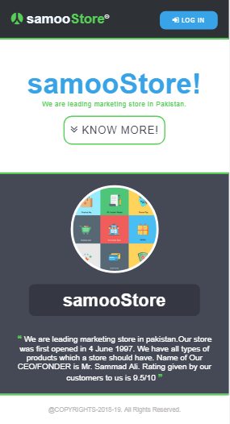
MAIN PAGE:

Slide 10
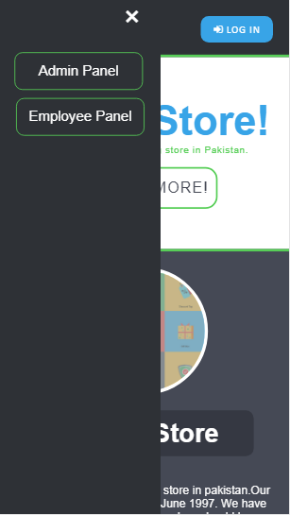
PANELS:

Slide 11
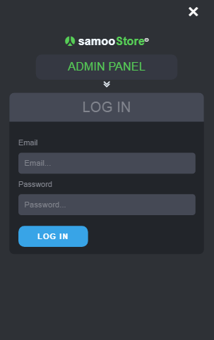
ADMIN PANEL

Slide 12
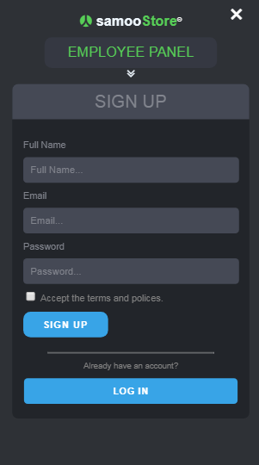
EMPLOYEE PANEL:SIGN UP

Slide 13
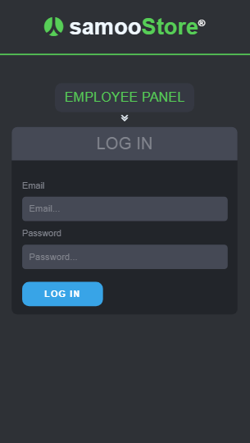
EMPLOYEE PANEL:LOGIN

Slide 14
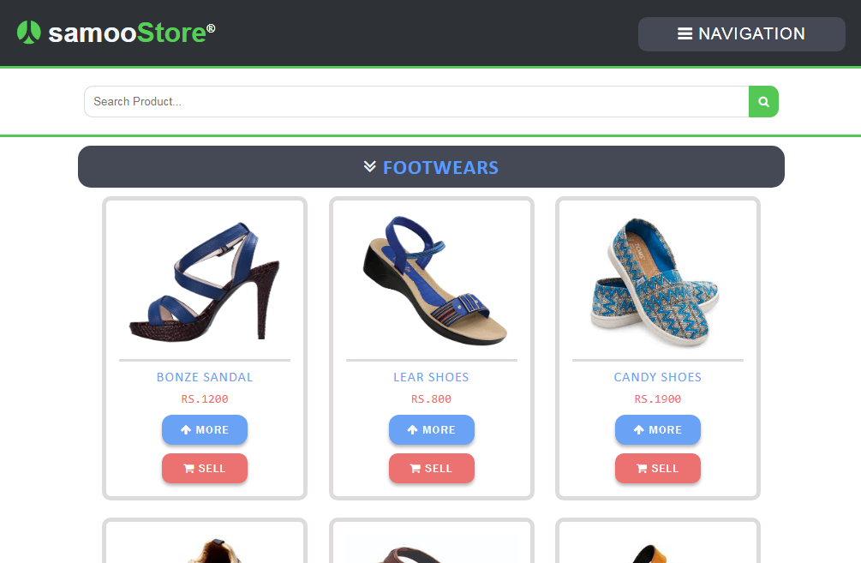
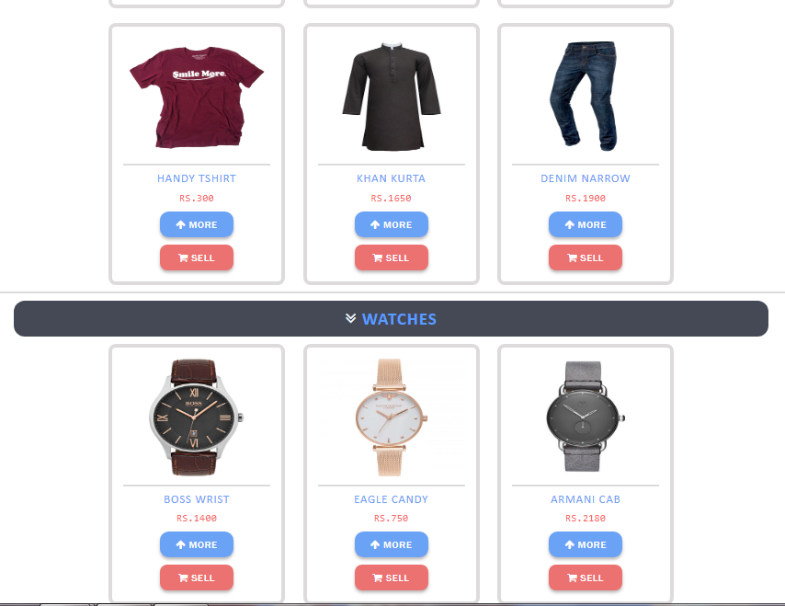
HOME PAGE:

Slide 15
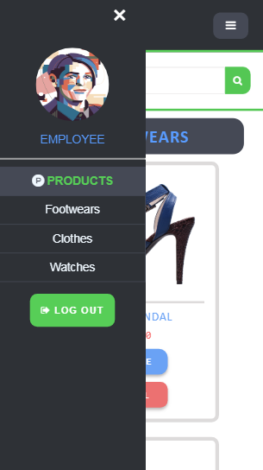
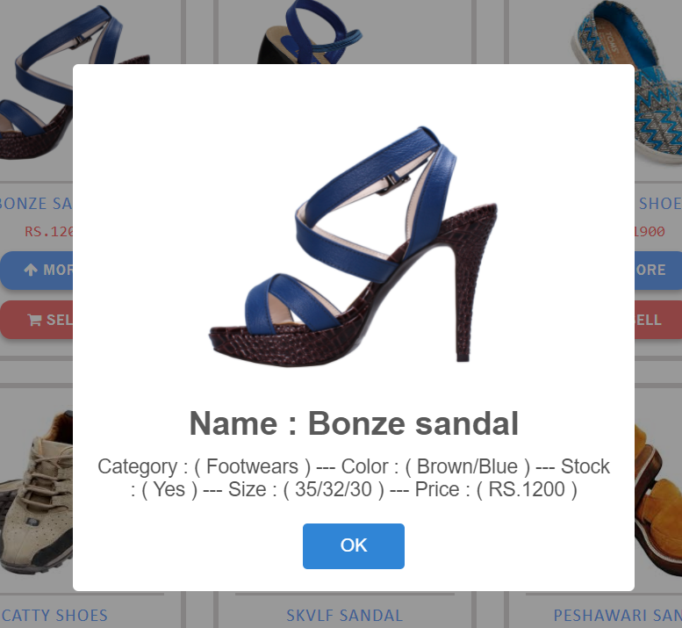
PRODUCTS:
Details of Product:

Slide 16
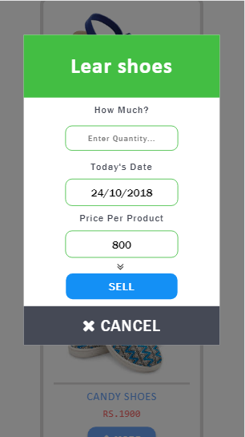
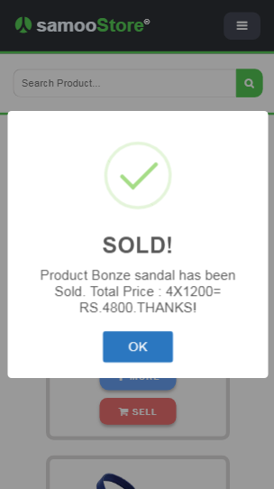
Selling a product:
Product Sold:

Slide 17
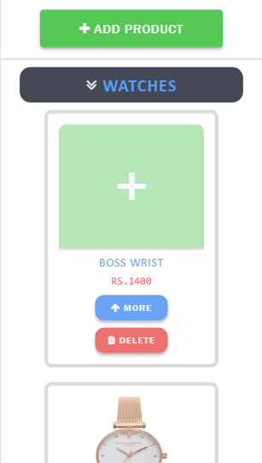
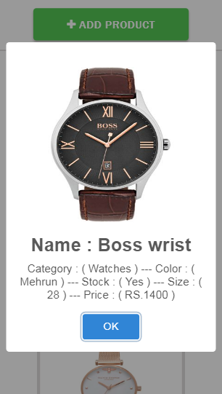
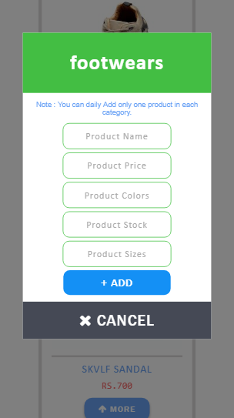
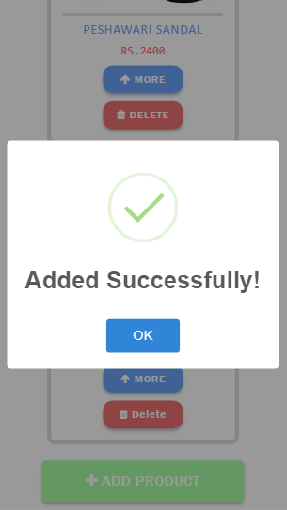
Adding a product to list:

Slide 18
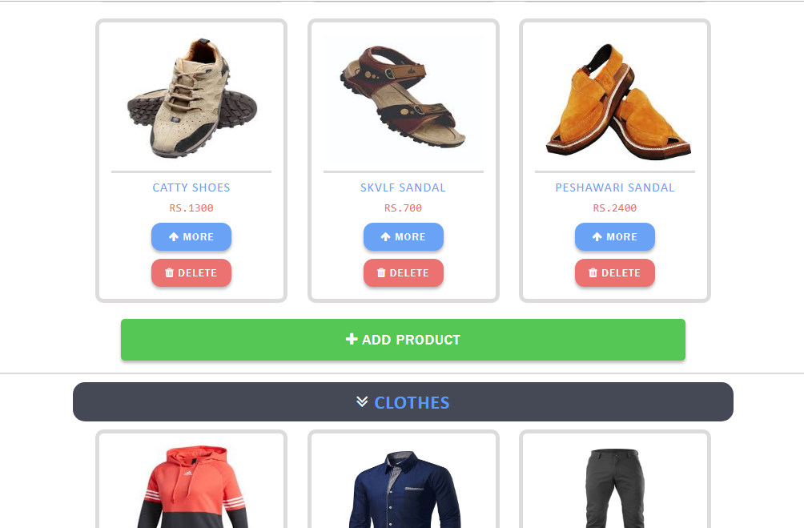
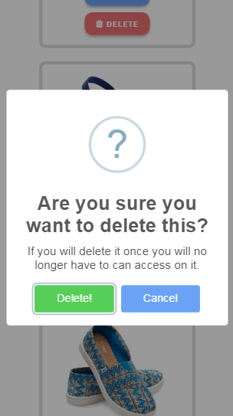
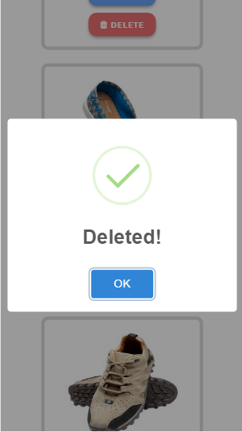
Deleting a product from the list:

Slide 19
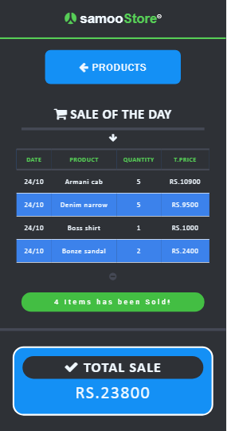
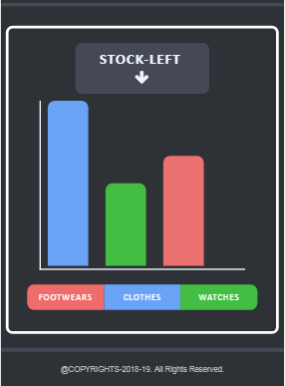
DASHBOARD:

Slide 20
THANK YOU

